Slide 1
Lecture 11
CS494 – Information System Audit and Control
6th May 2023

Slide 2
Brief Recap
What is the difference between Problem and Incident Management?
The objective of problem management is to prevent the recurrence of an incident by identifying the root cause of the incident and taking appropriate preventive action.
Incident management is achieving a return to a normal state as quickly as possible after an incident and thus minimizing the impact on the business.

Slide 3
What is IS auditor’s role in P&I management?
Both processes exist and approved?
How effective is the process ?
Problem / incident library being maintained ?
Root cause analysis is time boxed?
Implementations are timely carried out?
Testing of changes?

Slide 4
Network Management
Network management is the process of administering and maintaining a computer network.
It involves the use of various tools, techniques, and processes to ensure that a network operates efficiently, securely, and reliably.
Monitoring performance
Configuring network devices
Managing security
Managing network resources e.g. IP pools, domain names etc.
Troubleshooting
Future scaling

Slide 5
Change, configuration and patch management
Building upon what we studied earlier, this time keep hardware in mind also.
A change management process is used to change hardware, install software, and configure various network devices.
A change management process includes approval, testing, scheduling, and rollback arrangements. (Mail server example)

Slide 6
Change management best practices (self read)
All relevant personnel are informed of the change and when it is happening.
System, operations and program documentation are complete, up to date and in compliance with the established standards.
Job preparation, scheduling and operating instructions have been established.
System and program test results have been reviewed and approved by user and project management.
System conversion has occurred accurately and completely as evidenced by review and approval by user management.
Legal or compliance aspects have been considered.
The risk of adversely affecting the business operation are reviewed and a rollback plan is developed to back out the changes, if necessary.

Slide 7
Patch Management
Patch management is an area of systems management that involves acquiring, testing and installing multiple patches (code changes) to an computer system to maintain up-to-date software and often to address security risk.
Decide what patches are appropriate for particular systems.
Ensure that patches are installed properly; testing systems after installation.
Document all associated procedures, such as specific configurations required.

Slide 8
Release Management
The term release is used to describe a collection of authorized changes.
The release will typically consist of several problem fixes and enhancements to the service.
The releases, whether major or minor, will have a unique identity.
The releases are controlled, and, if any problems arise in the new release, one should be able to back out completely and restore the system to its previous state. E.g Meezan bank app
Suitable contingency plans may also be developed, if it is not completely restorable

Slide 9
What is the difference between release and patch management?
Releases address a wide variety of bugs in a product. It refers to bugs affecting stability, performance, proper operation of product features, and other areas. In contrast, a patch is focused on specific issues.

Slide 10
Auditing change management process
Get a list of changes from somewhere?
If not system generated, manually maintained?
View production files for last modified dates?
Sample from list of changes
Check if process was followed – obtain documentation.

Slide 11

Business Resilience

Slide 12
What does resilience mean?
The capacity to withstand or to recover quickly from difficulties.
Business resilience?
Business resilience describes an organization’s ability to adapt to disruptions and incidents in order to maintain continuous operations and to protect the organization’s assets.
Business Continuity Plan – Disaster Recovery Plan – Recovery Strategies

Slide 13
Business Impact Analysis (BIA)
Expect a question in the final
A BIA determine critical processes and resources that have a considerable impact on the business.
It identifies technology components as well that support these business processes
It determines processes to be recovered as a priority so as to ensure an organization's survival.

Slide 14
Business Impact Analysis (BIA)
In order to conduct a successful BIA, it is necessary to obtain an understanding of the organization and key business processes and its dependency on IT and other resources.
BIA (Business Impact Analysis) is a process that helps organizations identify and prioritize their critical business functions and processes.

Slide 15
Business Impact Analysis (BIA)
The involvement of senior management, the IT department, and end users is critical in terms of conducting a BIA successfully.
Why?
So what is the objective of a BIA?

Slide 16
Business Impact Analysis – Some approaches
A questionnaire approach involves developing a detailed set of questions and circulating it to key users. The information obtained is then tabulated and analyzed to develop a BIA.
What are the potential impacts if these processes and resources were to be disrupted, such as loss of revenue, loss of customer confidence, or damage to the organization's reputation?
What are the dependencies between different business processes and resources, and how would a disruption to one area affect others?
What are the resource requirements for each critical process or resource, such as personnel, technology, or physical facilities?

Slide 17
Business Impact Analysis – Some approaches
An interview / meeting approach involves interviewing key users. The information obtained is tabulated and analyzed to develop a BIA.
As far as is possible, the BIA team should also consider past transaction history to determine possible impacts if systems are not available as a result of a particular incident.

Slide 18
Business Impact Analysis
After determining critical processes, define potential impacts?
Financial loss
Reputation loss (cloud provider going down)
Legal / regulatory impacts
Assess Impact severity - Once the BIA is available for each process, it is important to prioritize the processes that need to be recovered first.
This criticality analysis should be performed in co- ordination with IT and business users
The business process owner possesses the most relevant information relating to processes, and so they are regarded as the best source for determining process criticality

Slide 19
Business Impact Analysis
Once the critical assets have been determined through the BIA, the next step is to develop a recovery strategy.
Recovery strategy ensures that critical assets are recovered as soon as possible to minimize the impact of the disaster.
A recovery strategy is primarily influenced by the BIA. Recovery strategies are part of Disaster Recovery Planning section.

Slide 20
System Resilience
How well can your applications withstand disaster situations and recover within set metrics and recovery time?
Clustering - software that runs on every node your applications are installed on. It includes management software that allows to control the cluster behavior.
Main objective of clustering is High Availability.

Slide 21
High Availability vs Fault tolerant
HA aims for high application uptime with minimal disruptions. E.g. 99.9% availability. In case of any component failure, redundant resources are started to take over resulting in minimal downtime.
In an VM cluster environment, if one host fails, VM software can restart another host on a different machine.
FT systems are designed to keep working even if one or more components fail. There is zero downtime in FT systems.
E.g. RAID ( redundant array of inexpensive disks).

Slide 22
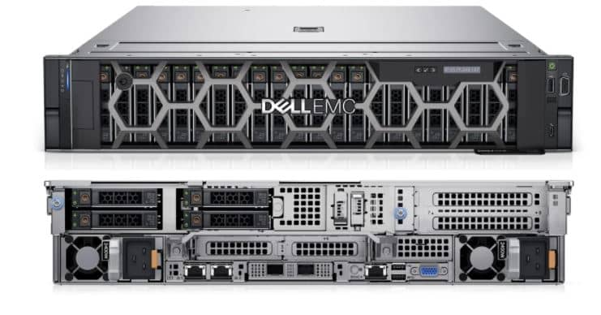

Slide 23
What goes into consideration of HA vs FT
Business criticality
Cost – FT costs more then HA
Minimal downtime during maintenance activities
Strategy is decided as per BIA.

Slide 24
Communication Resilience
Telco network failure? E.g. fiber cut
Have backup fiber in place with auto configuration to switch.
Should backup of fiber be fiber? Both can get cut.
Use a different route for a different fiber.
Use a wireless medium as backup
FedEx CS example.

Slide 25
Data backup, storage and restoration – 321 Rule
Copy of data stored in a remote / offsite location. Why?
Can be used in an event of a data loss event.
Documented data backup policy is in place.
Backups can be on different mediums e.g. disks, cds, tape drives, cloud etc.
3: Keep 3 copies of your data
2: Store the data copies on 2 different devices or media types
1: Store 1 copy of data offsite

Slide 26
Data backup, storage and restoration
Types of backup strategies:
Full backup - In a full backup, the entire database / data is backed up every time, regardless of previous backup.
Full backups consume a lot of time and space. But provide single repository of all data.

Slide 27
Data backup, storage and restoration
2. Incremental backup - An incremental backup copies the files and folders that changed or are new since the last incremental or full backup.
Let's say you have a folder containing a large number of files and you perform a full backup of the folder on Sunday.
On Monday, you make some changes to a few files in the folder. Instead of backing up the entire folder again, an incremental backup will only back up the changes made to those specific files on Monday.
On Tuesday, you make some more changes to other files in the folder. The incremental backup will only back up the changes made to those files since Monday, not the entire folder.

Slide 28
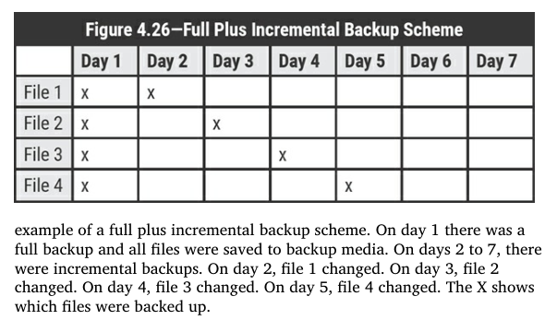

Slide 29
Data backup, storage and restoration
This approach reduces the backup time, storage space required, and bandwidth needed to transfer the data to the backup location.
In general, it's recommended to take a full backup at regular intervals, such as weekly or monthly, and supplement it with incremental backups taken daily or more frequently, depending on the rate of change of the data.
The exact interval for full backups may also depend on regulatory compliance or other business requirements.

Slide 30
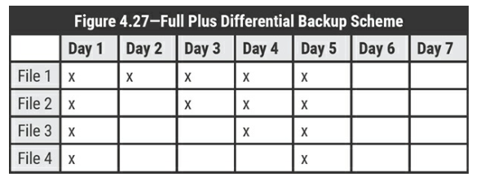
Data backup, storage and restoration
3. Differential Backup - A differential backup copies all files and folders that have been added or changed since a full backup was performed
Day 1 – Full Backup of all files
Day 2 – File 1 changed
Day 3 – File 2 changed
Day 4 – File 3 changed
Day 5 – File 4 changed

Slide 31
Full vs Incremental vs Differential
Storage wise:
• Full backup: Requires more time and storage capacity compared with the other two schemes
• Differential: Requires less time and storage capacity compared with a full backup, but more than an incremental backup
• Incremental: Requires less time and storage capacity compared with the other two schemes

Slide 32
Full vs Incremental vs Differential
Restoration capability wise:
• Full backup: The fastest of all three schemes
• Differential: Slower than a full backup, but faster than an incremental backup
• Incremental: The slowest of all three schemes

Slide 33
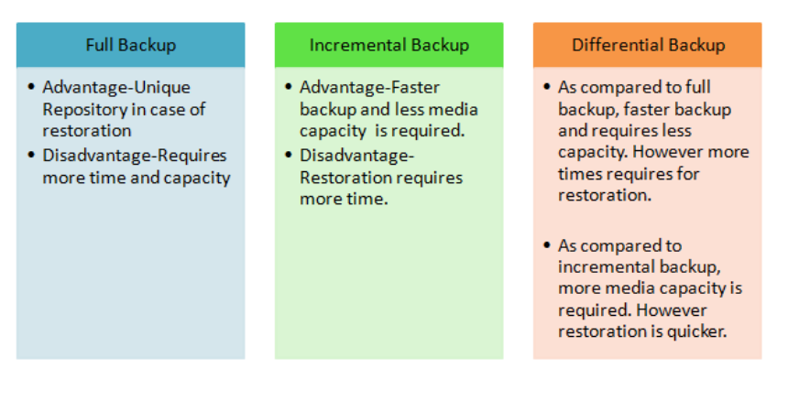
Advantages and Disadvantage of each strategy

Slide 34
Restoration
Regular restoration is highly recommended to ensure backup copies are functional
Depending on media type and criticality, restoration schedule should be performed and results documented.
IS auditor would review data backup policies, cross check with actual backups and restoration activities.

Slide 35
Business Continuity Plan
The objective of a BCP is to manage and mitigate the risk of disaster so that the continuity of business operations can be ensured.
The process of creating a plan to ensure that essential business functions can continue to operate during and after a disruptive event.
BCP requires approval and support of senior management, else alignment would be a question mark.
Process owners are key stakeholders for the BCP

Slide 36
Business Continuity Plan
BCP plans should clearly identify roles and responsibilities for specific tasks in the event of a disaster.
It is important to nominate a key employee who will declare a disaster, thereby invoking the BCP.

Slide 37
Business Continuity Plan steps
BIA - identifying critical business functions, prioritizing them, and assessing the impact of their disruption
Risk Assessment – assessing threats/vulnerabilities to above processes
Develop BCP plan - Based on the BIA and risk assessment, develop a comprehensive BCP that outlines the steps to be taken in the event of a disruption. This includes identifying critical resources, defining recovery objectives, and developing recovery strategies.

Slide 38
Business Continuity Plan steps
Plan Testing and Training: Regularly test the BCP to ensure that it is effective and up-to-date. This includes testing the plan in different scenarios and conducting training sessions for employees to ensure that they are familiar with the plan
Plan maintenance: Regularly review and update the BCP to ensure that it remains relevant and effective. This includes reviewing the plan after each test and making any necessary changes based on feedback and new information.

Slide 39
Business Continuity Plan steps
Communication: Ensure that all employees and stakeholders are aware of the BCP and their roles and responsibilities in the event of a disruption. This includes establishing communication channels and protocols for communicating with employees, customers, suppliers, and other stakeholders during a disruption

Slide 40
Disaster Recovery Planning
It is the process of developing a plan to restore IT systems and data following a disruptive event such as a natural disaster, cyber attack, or other unexpected incident.
DR planning entails costs. Downtime costs and Recovery costs.
Downtime costs include a loss of sales, idle resources, salaries, and when production or service is at a standstill due to a disaster, and these costs tend to increase over time.

Slide 41
Disaster Recovery Planning
Recovery costs are the costs associated with recovery procedures, such as additional costs related to the activation of the alternate site, and the costs related to the reparation of damaged assets.
To maintain a DRP, additional costs in the form of resources, the recovery site, testing, and other maintenance will result in additional costs
The objective of a structured DRP is to minimize both downtime and recovery costs during a disaster

Slide 42
BCP vs DRP
The objective of the BCP is to keep businessoperations functioning either from an alternate location or by means of alternative tools and processes.
The objective of the DRP is to restore normal business operations and to recover from a disaster. DRP deals with technological aspect of the BCP.

